Slide 1

CSC 203 / CPE 203
Week 2
Project-Based Object-Oriented
Programming and Design
(using Java)
Bill Foote
wffoote@calpoly.edu
(http://jovial.com)
Notes:
M: 1-14
T:; 1-22
W: To, or through python vars
R: UP to javadocs @ end
F: through 49

Slide 2
A quick tour of the javadocs...
https://docs.oracle.com/javase/9/docs/api/index.html?overview-summary.html
  (file:///home/wffoote/docs/jdk-9.0.4/api/index.html?overview-summary.html)
Notes:
10 minutes needed after this

Slide 3
Including libraries
$ javac *.java
<...>
100 errors
$ export CLASSPATH="/home/wffoote/cpe203/general/libs/ham crest-core-1.3.jar:/home/wffoote/cpe203/general/libs/juni t-4.12.jar:."
$ javac *.java
$ java org.junit.runner.JUnitCore TestCases
JUnit version 4.12
................
Time: 0.018
OK (16 tests)

Slide 4
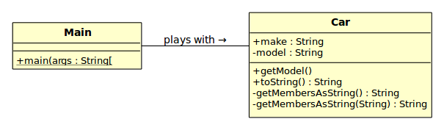
Creating your own objects
(see 1_car)
Notes:
LAST SLIDE!
Terminal, week01/Car.java

Slide 5
Assignment 1
(not to be confused with Lab 1)

Slide 6
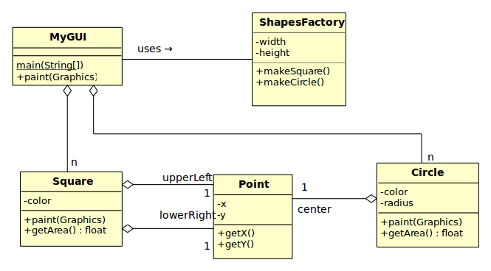
Testing code
Notes:
Introducing a little program to draw some stuff. First, let’s test the classes!

Slide 7

https://junit.org/junit4/
org.junit.JUnitCore, org.junit.Assert

Slide 8
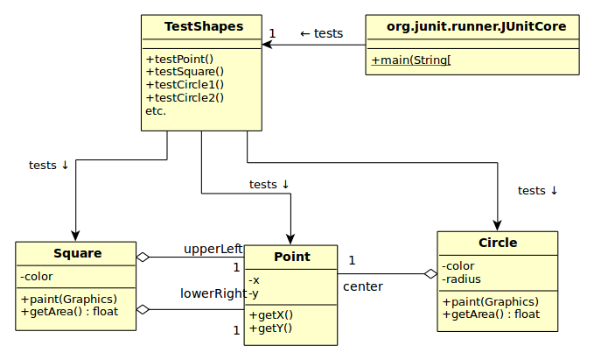
Notes:
cf. 2_testing/TestShapes

Slide 9
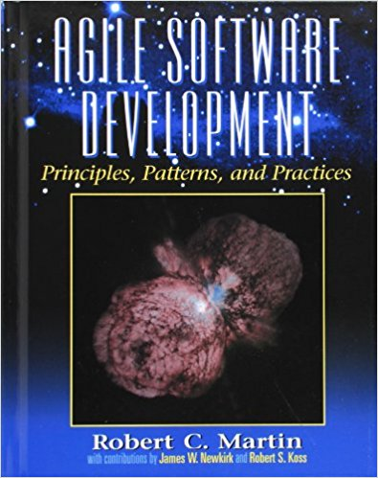
Single Responsibility Principle
“A class / module / etc. should have only one reason to change”
  Martin, Robert C. (2003). Agile Software Development, Principles, Patterns, and Practices
  “do one thing only,” but what is “one thing?”
Other ways we’ve said this:
  “High cohesion, low coupling”
  “Encapsulation”
  “Separation of concerns”
  “information hiding”

Slide 10
Testing code
Do Square and Circle each have a single responsibility?
Notes:
Introducing a little program to draw some stuff. First, let’s test the classes!

Slide 11
Homework
Lab 0 debrief
  34 submitted (of 36)
Lab 1 debrief
  29 submitted

Slide 12
Development Environment

Slide 13
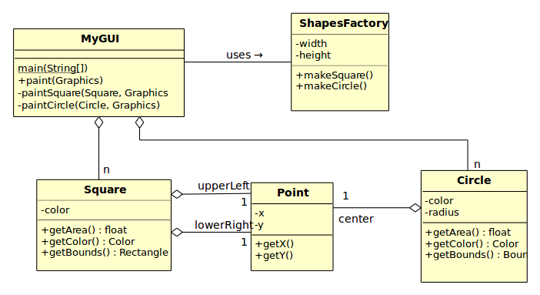

Slide 14
Java Mechanisms
public vs. private
  (and package-private)
Method overloading
Constructors
Instance members (methods & fields) vs. static
getters and setters
final

Slide 15
Next Week
Chapter 5, “Inheritance,” except IGNORE anything to do with reflection!

